Slide 1
2022 GUBERNATORIAL RACES OVERVIEW
BY: FLYWHEEL GOVERNMENT SOLUTIONS
Updated October 20, 2022

Slide 2
OVERVIEW OF 2022 GUBERNATORIAL RACES
Election Day is November 8th
There are 36 Governors Races happening in November this year.
Republicans have 20 seats to defend
Democrats have 16 seats to defend
Of the 36 races, 8 of them are open seats because of term limits or retirements
The following slides lay out the races as they are going through primaries. These will be constantly updated and shared
*denotes top candidate according to polls

Slide 3
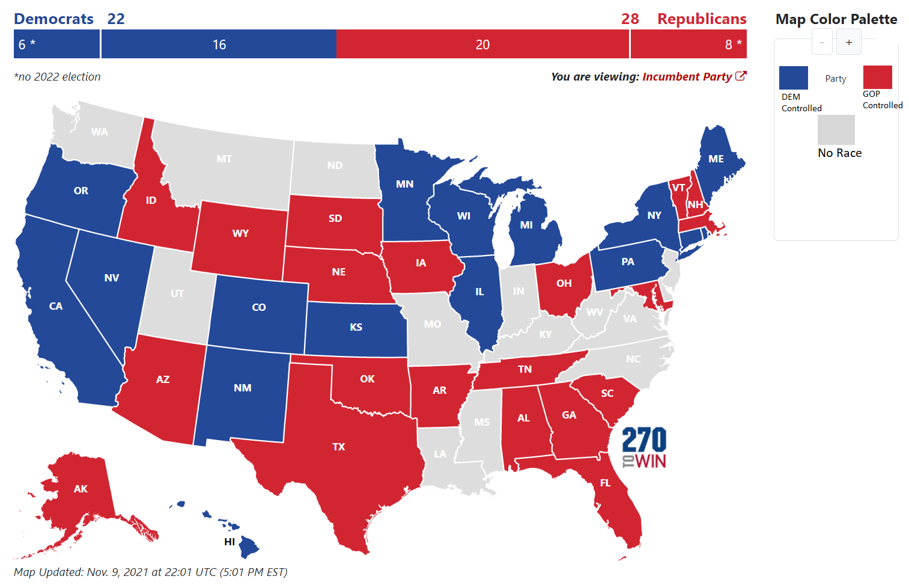
2022 CURRENT MAP

Slide 4
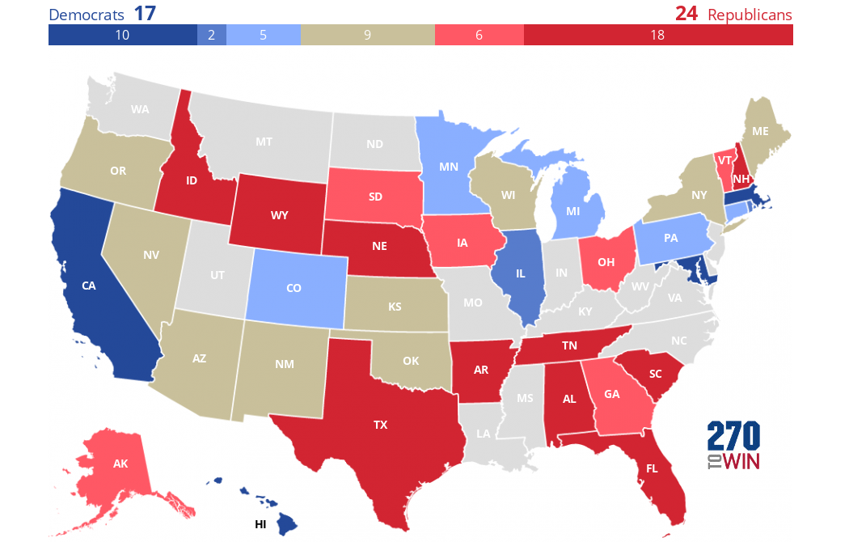
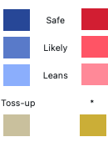
2022 CURRENT PREDICTIONS

Slide 5
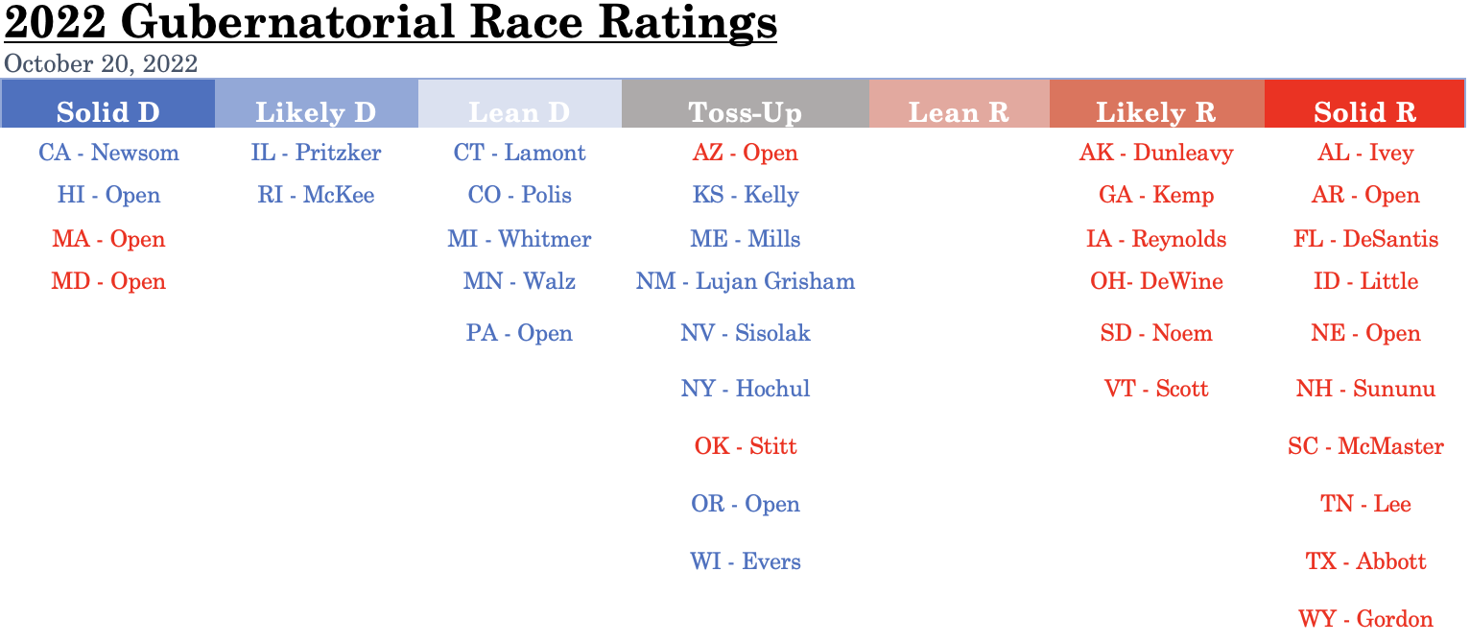

Slide 6
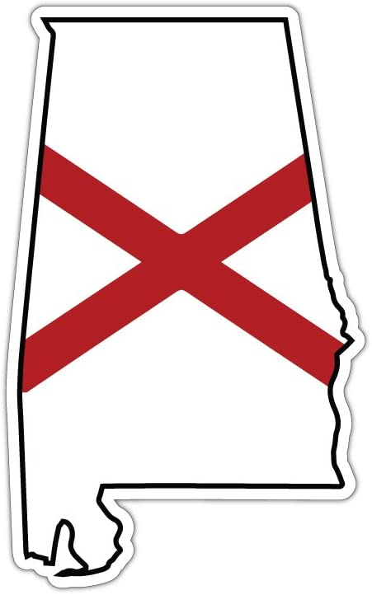
ALABAMA
REPUBLICAN HELD
Incumbent: Governor Kay Ivey*
Democrat Challenger:
Yolanda Flowers
Independent Challenger:
Jared Budlong
Libertarian Challenger:
James Blake
Other Factors to Consider:
U.S. Senate Race
Incumbent: Open
Prediction:
Solid Republican

Slide 7
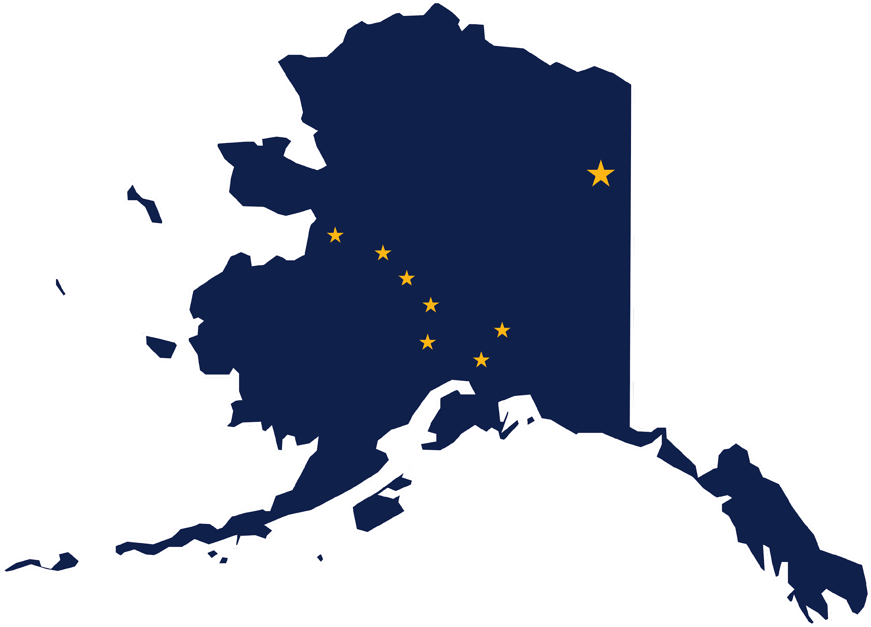
ALASKA
REPUBLICAN HELD
Incumbent: Governor Mike Dunleavy*
Republican Challenger:
Charlie Pierce
Democrat Challenger:
Les Gara
Independent Challenger:
Former Gov Bill Walker
Polling Data:
Les Gara: 47%
Gov. Mike Dunleavy: 53%
(Alaska Survey Research)
(September 27th)
Les Gara: 41%
Gov. Mike Dunleavy: 59%
(Fabrizio Ward Polling)
(September 15th)
Other Factors to Consider:
U.S. Senate Race
Incumbent: Lisa Murkowski ®
Ranked-Choice Voting
Pierce’s votes likely to go majority to Gov. Dunleavy
Walker’s votes likely to go majority to Gara
Prediction:
Likely Republican

Slide 8
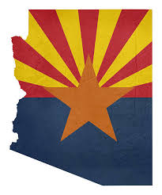
ARIZONA
REPUBLICAN HELD
Incumbent: OPEN SEAT
Republican Candidate:
Kari Lake*
Democrat Candidate:
Katie Hobbs*
Independent-Green Candidate:
William Pounds
Libertarian Candidate:
Barry Hess
Polling Data:
Katie Hobbs: 46%
Kari Lake: 59%
(Insider Advantage)
(October 11th)
Katie Hobbs: 49%
Kari Lake: 49%
(YouGov Polling)
(October 4th)
Katie Hobbs: 49%
Kari Lake: 44%
(SSRS Polling)
(October 2nd)
Other Factors to Consider:
U.S. Senate Race
Incumbent: Mark Kelly (D)
Prediction:
Toss-Up

Slide 9
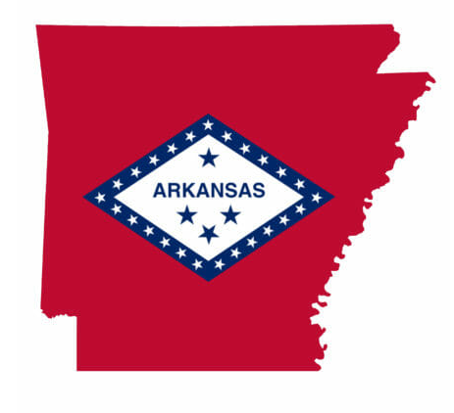
ARKANSAS
REPUBLICAN HELD
Incumbent: OPEN SEAT
Write-In Candidates:
Jason Tate
Michael Woodard
Dan Nelson
Elvis Presley
Republican Candidate:
Sarah Huckabee Sanders*
Democrat Candidate:
Chris Jones
Libertarian Candidate:
Ricky Dale Harrington Jr.
Polling Data:
Chris Jones: 32%
Sarah Huckabee Sanders: 62%
(Echelon Insights Polling)
(September 15th)
Chris Jones: 40%
Sarah Huckabee Sanders: 51%
(Hendrix College Polling)
(September 12th)
Other Factors to Consider:
U.S. Senate Race
Incumbent: John Boozman (R)
Prediction:
Solid Republican

Slide 10
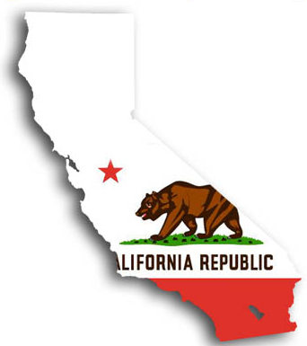
CALIFORNIA
DEMOCRAT HELD
Incumbent: Governor Gavin Newsom*
Republican Challenger:
Brian Dahle
Polling Data:
Gov. Gavin Newsom: 57%
Brian Dahle: 35%
(SurveyUSA Polling)
(October 10th)
Gov. Gavin Newsom: 53%
Brian Dahle: 32%
(UC Berkeley Polling)
(September 27th)
Gov. Gavin Newsom: 58%
Brian Dahle: 31%
(Public Policy Institute of California Polling)
(September 11th)
Other Factors to Consider:
U.S. Senate Race
Incumbent: Alex Padilla (D)
Prediction:
Solid Democrat

Slide 11
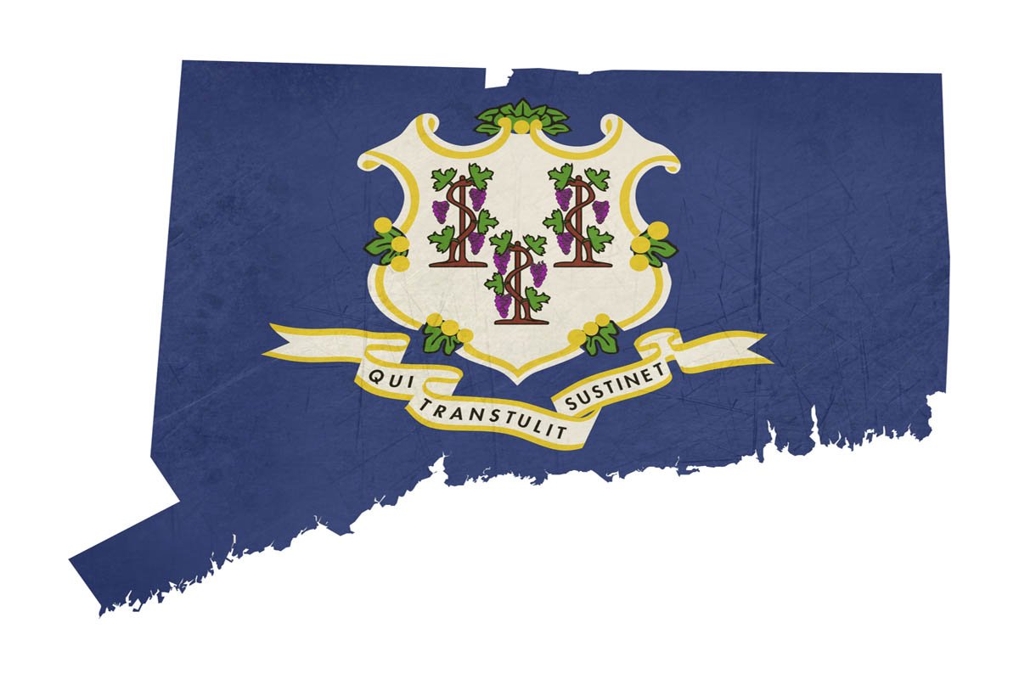
CONNECTICUT
DEMOCRAT HELD
Incumbent: Governor Ned Lamont*
Green Challenger:
Michelle Louise Bicking
Republican Challenger:
Bob Stefanowski
Independent Challenger:
Robert Hotaling
Libertarian Challenger:
Aaron Lewis
Polling Data:
Gov. Ned Lamont: 50%
Bob Stefanowski: 43%
(Emerson College Polling)
(October 13th)
Gov. Ned Lamont: 55%
Bob Stefanowski: 40%
(Western New England U.)
(September 21st)
Gov. Ned Lamont: 57%
Bob Stefanowski: 40%
(Quinnipiac University)
(September 19th)
Other Factors to Consider:
U.S. Senate Race
Incumbent: OPEN
Prediction:
Lean Democrat

Slide 12
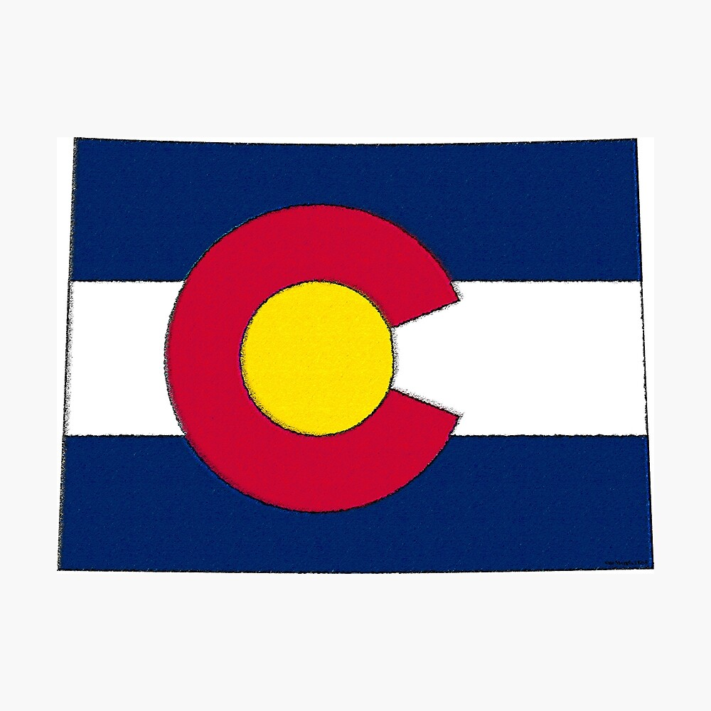
COLORADO
DEMOCRAT HELD
Incumbent: Governor Jared Polis*
Republican Challenger:
Heidi Ganahl
American Constitution
Party Challenger:
Daniel Neuschwanger
Libertarian Challenger:
Kevin Ruskusky
Unity Party Challenger:
Paul Fiorino
Independent Challengers:
Zachary Varon
Paul Willmon
Polling Data:
Gov. Jared Polis: 56%
Heidi Ganahl: 39%
(Data for Progress)
(October 6th)
Gov. Jared Polis: 54%
Heidi Ganahl: 39%
(Marist College)
(October 6th)
Gov. Jared Polis: 49%
Heidi Ganahl: 41%
(Trafalgar Polling)
(September 24th)
Other Factors to Consider:
U.S. Senate Race
Incumbent: Michael Bennet (D)
Prediction:
Lean Democrat

Slide 13
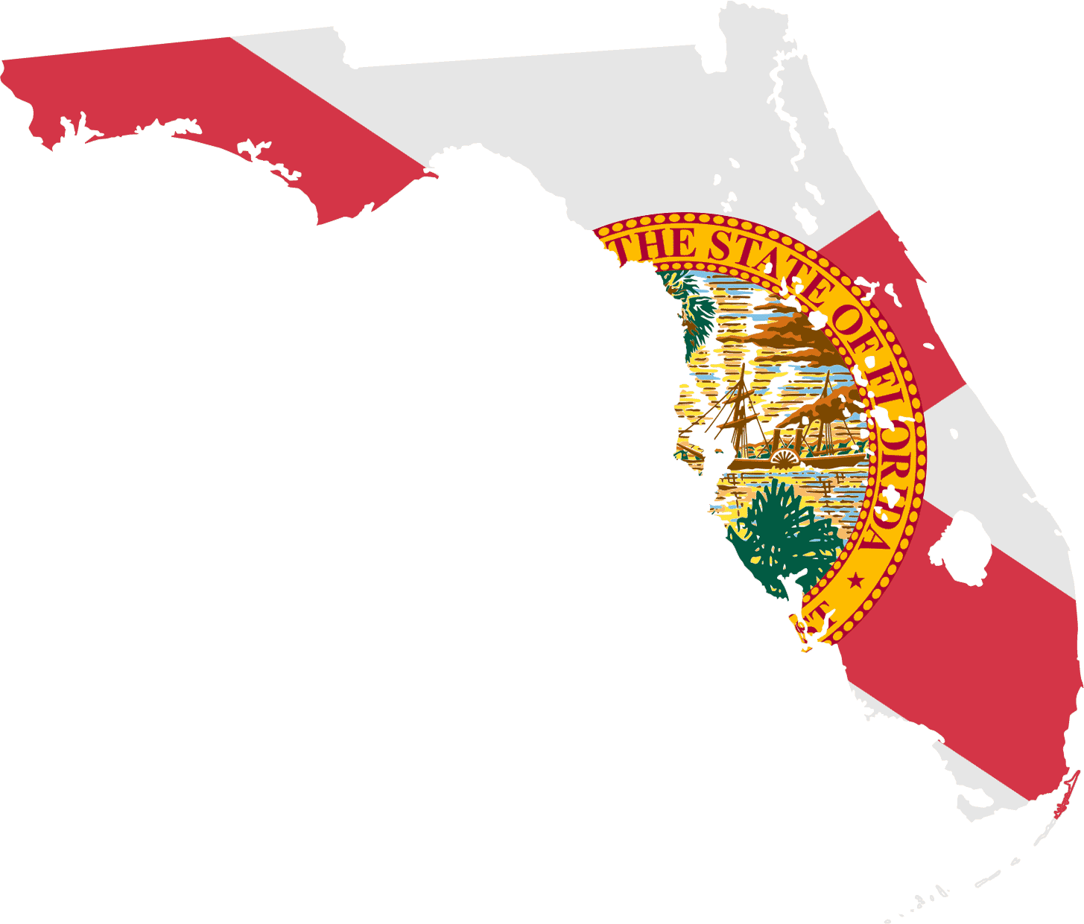
FLORIDA
REPUBLICAN HELD
Incumbent: Governor Ron DeSantis*
Democrat Challenger:
Charlie Crist
Libertarian Challenger:
Hector Roos
No Party Affiliation Challenger:
Carmen Gimenez
Polling Data:
Charlie Crist: 42%
Gov. Ron DeSantis: 52%
(Sachs Media)
(October 15th)
Charlie Crist: 41%
Gov. Ron DeSantis: 52%
(Mason-Dixon Polling)
(September 28th)
Charlie Crist: 46%
Gov. Ron DeSantis: 47%
(Clarity Campaign Labs)
(September 27th)
Other Factors to Consider:
U.S. Senate Race
Incumbent: Marco Rubio (R)
Challenger: Val Demings (D)
Prediction:
Solid Republican

Slide 14
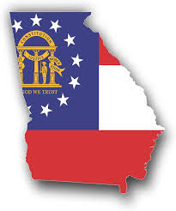
GEORGIA
REPUBLICAN HELD
Incumbent: Governor Brian Kemp*
Democrat Challenger:
Stacey Abrams*
Libertarian Challenger:
Shane Hazel
Independent Challengers:
David Byrne Bartell
Milton Lofton
Polling Data:
Stacey Abrams: 43%
Gov. Brian Kemp: 50%
(Insider Advantage)
(October 16th)
Stacey Abrams: 46%
Gov. Brian Kemp: 51%
(Emerson College)
(October 10th)
Stacey Abrams: 45%
Gov. Brian Kemp: 51%
(Landmark Communications)
(October 4th)
Other Factors to Consider:
U.S. Senate Race
Incumbent: Raphael Warnock (D)
Challenger: Herschel Walker (R)
Prediction:
Likely Republican

Slide 15
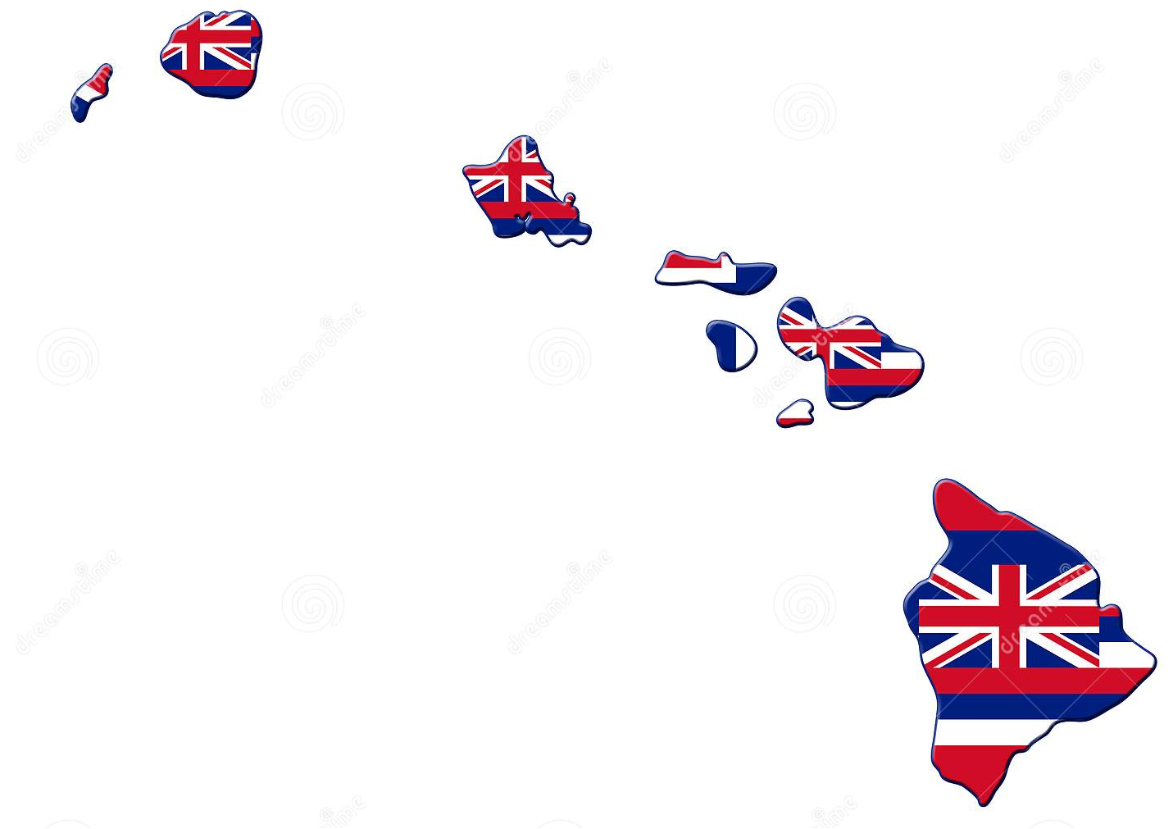
HAWAII
DEMOCRAT HELD
Incumbent: OPEN
Republican Candidate:
Duke Aiona
Democrat Candidate:
Joshua Green*
Other Factors to Consider:
U.S. Senate Race
Incumbent: OPEN
Prediction:
Solid Democrat

Slide 16
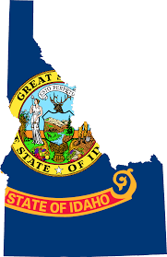
IDAHO
REPUBLICAN HELD
Incumbent: Governor Brad Little*
Democrat Challenger:
Stephen Heidt
Independent Challenger:
Ammon Bundy
Constitution Party Challenger:
Chantyrose Davison
Libertarian Challenger:
Paul Sand
Other Factors to Consider:
U.S. Senate Race
Incumbent: Mike Crapo (R)
Challenger: David Roth (D)
Party Registration in Idaho:
Republican: 53.6%
Democrat: 13.6%
Prediction:
Solid Republican

Slide 17
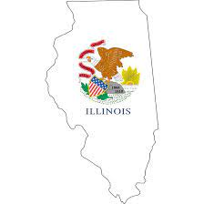
ILLINOIS
DEMOCRAT HELD
Incumbent: Governor J.B. Pritzker*
Republican Challenger:
Darren Bailey
Independent Challengers:
Shon-Tiyon Horton
Elizabeth Sebesta
Polling Data:
Gov. J.B. Pritzker: 49%
Darren Bailey: 34%
(Public Policy Polling)
(October 11th)
Gov. J.B. Pritzker: 50%
Darren Bailey: 45%
(Fabrizio, Lee & Associates)
(September 27th)
Gov. J.B. Pritzker: 51%
Darren Bailey: 36%
(Emerson College)
(September 23rd)
Other Factors to Consider:
U.S. Senate Race
Incumbent: Tammy Duckworth (D)
Challenger: Kathy Salvi (R)
Prediction:
Likely Democrat

Slide 18
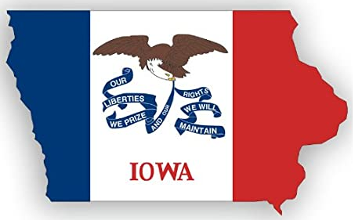
IOWA
REPUBLICAN HELD
Incumbent: Governor Kim Reynolds*
Democrat Challenger:
Deidre DeJear
Libertarian Challenger:
Rick Stewart
Polling Data:
Deidre DeJear: 35%
Gov. Kim Reynolds: 52%
(Des Moines Register)
(October 12th)
Deidre DeJear: 36%
Gov. Kim Reynolds: 59%
(Cygnal Polling)
(October 4th)
Other Factors to Consider:
U.S. Senate Race
Incumbent: Chuck Grassley (R)
Challenger: Michael Franken (D)
Prediction:
Likely Republican

Slide 19
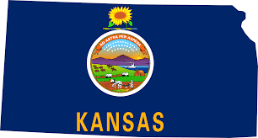
KANSAS
DEMOCRAT HELD
Incumbent: Governor Laura Kelly*
Republican Challenger:
Derek Schmidt*
Libertarian Challenger:
Seth Cordell
Independent Challenger:
Dennis Pyle
Polling Data:
Gov. Laura Kelly: 45%
Derek Schmidt: 43%
(Emerson College Polling)
(September 18th)
Gov. Laura Kelly: 47%
Derek Schmidt: 44%
(Charity Campaign Labs)
(September 15th)
Gov. Laura Kelly: 53%
Derek Schmidt: 41%
(Echelon Insights Polling)
(September 7th)
Other Factors to Consider:
U.S. Senate Race
Incumbent: Jerry Moran (R)
Biden Approval / Disapproval:
As of January, ’22:
30 fave / 50 unfave
Prediction:
Toss-Up

Slide 20
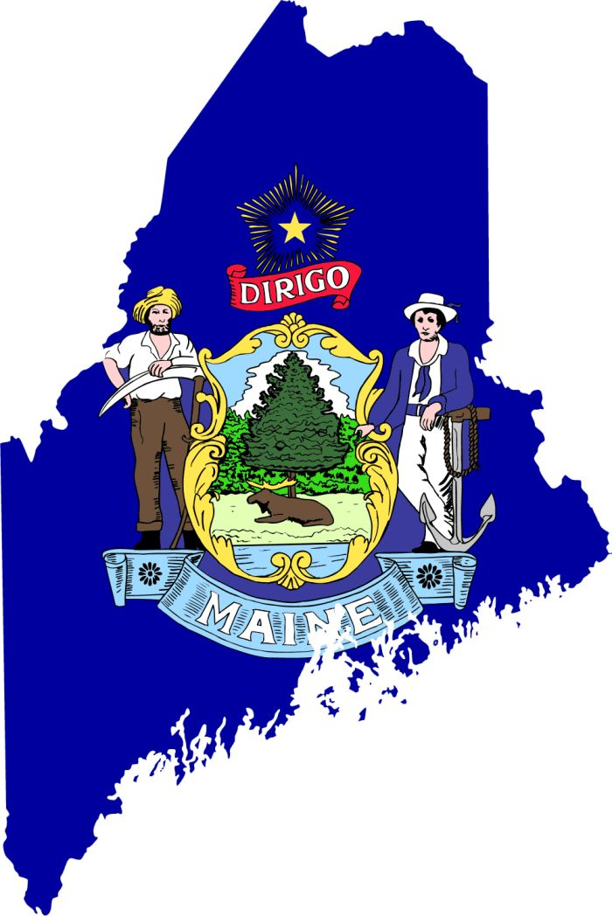
MAINE
DEMOCRAT HELD
Incumbent: Governor Janet Mills
Republican Challenger:
Former Governor Paul LePage*
Independent Challenger:
Sam Hunkler
Polling Data:
Gov. Janet Mills: 53%
Paul LePage: 41%
(Maine People’s Resource Center Polling)
(September 20th)
Gov. Janet Mills: 53%
Paul LePage: 39%
(U. of New Hampshire)
(September 19th)
Prediction:
Toss-Up

Slide 21
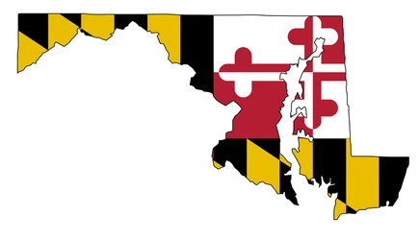
MARYLAND
REPUBLICAN HELD
Incumbent: OPEN
Republican Candidate:
Dan Cox
Democrat Candidate:
Wes Moore*
Libertarian Candidate:
David Lashar
Independent Candidate:
Kyle Sefcik
Green Candidate:
Nancy Wallace
Working Class Party Candidate
David Harding
Polling Data:
Wes Moore: 60%
Dan Cox: 28%
(University of Maryland)
(September 27th)
Wes Moore: 53%
Dan Cox: 31%
(Goucher College Polling)
(September 12th)
Other Factors to Consider:
U.S. Senate Race
Incumbent: Chris Van Hollen (D)
Prediction:
Solid Democrat

Slide 22
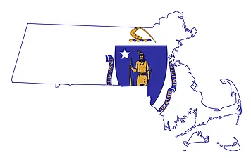
MASSACHUSETTS
REPUBLICAN HELD
Incumbent: OPEN
Republican Candidate:
Geoff Diehl
Democrat Candidate:
Maura Healey*
Independent Candidate:
Dianna Ploss
Libertarian Candidate:
Kevin Reed
Polling Data:
Maura Healey: 56%
Geoff Diehl: 33%
(Boston Globe)
(October 20th)
Maura Healey: 52%
Geoff Diehl: 26%
(Suffolk University)
(September 13th)
Maura Healey: 52%
Geoff Diehl: 34%
(Emerson College Polling)
(September 8th)
Prediction:
Solid Democrat

Slide 23
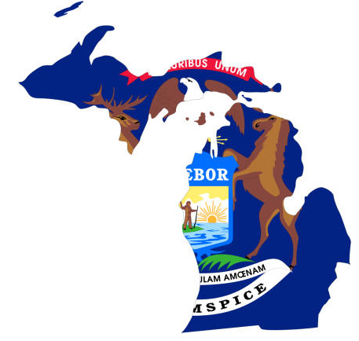
MICHIGAN
DEMOCRAT HELD
Incumbent: Governor Gretchen Whitmer*
U.S. Taxpayers Party Challenger:
Donna Brandenburg
Natural Law Party Challenger:
Daryl Simpson
Republican Challenger:
Tudor Dixon
Green Party Challenger:
Kevin Hogan
Libertarian Challenger:
Mary Buzuma
Polling Data:
Gov. Gretchen Whitmer: 49%
Tudor Dixon: 44%
(Emerson College)
(October 14th)
Gov. Gretchen Whitmer: 48%
Tudor Dixon: 44%
(Glengariff Group)
(October 14th)
Gov. Gretchen Whitmer: 53%
Tudor Dixon: 47%
(YouGov)
(October 6th)
Prediction:
Lean Democrat

Slide 24
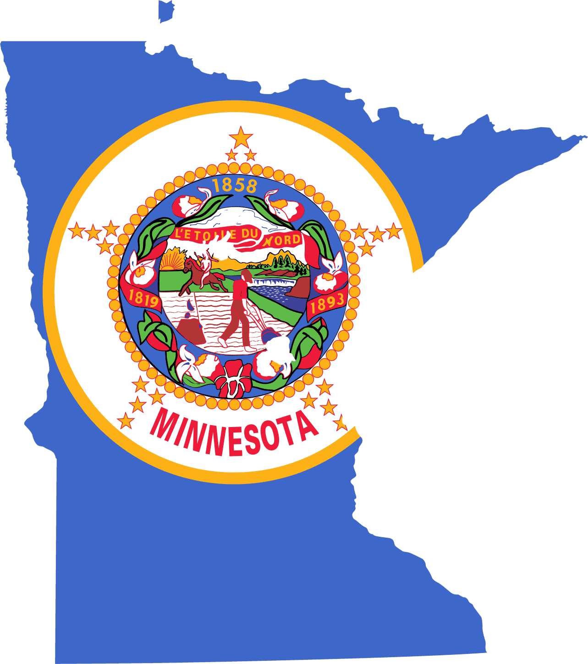
MINNESOTA
DEMOCRAT HELD
Incumbent: Governor Tim Walz*
Legal Marijuana Now Challenger:
James McCaskel
Social Workers Party Challenger:
Gabrielle Prosser
Republican Challenger:
Scott Jensen*
Independence Party Challenger:
Hugh McTavish
Grassroots-Legalize Cannabis Challenger:
Steve Patterson
Polling Data:
Gov. Tim Walz: 47%
Scott Jensen: 42%
(MinnPost)
(October 14th)
Gov. Tim Walz: 48%
Scott Jensen: 41%
(Mason-Dixon Polling)
(September 14th)
Gov. Tim Walz: 48%
Scott Jensen: 45%
(Trafalgar Group)
(September 14th)
Other Factors to Consider:
Generic Ballot as of March ‘22:
47R / 43D
Prediction:
Lean Democrat

Slide 25
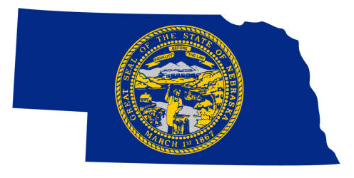
NEBRASKA
REPUBLICAN HELD
Incumbent: OPEN
Republican Candidate:
Jim Pillen*
Democrat Candidate:
Carol Blood
Libertarian Candidate:
Scott Zimmerman
Polling Data:
Carol Blood: 41%
Jim Pillen: 48%
(SurveyUSA)
(September 28th)
Prediction:
Solid Republican

Slide 26
NEVADA
DEMOCRAT HELD
Incumbent: Governor Steve Sisolak*
Republican Challenger:
Joe Lombardo*
Independent Challenger:
Edward Bridges II
Libertarian Challenger:
Brandon Davis
Other Factors to Consider:
U.S. Senate Race
Incumbent: Catherine Cortez Masto (D)
Challenger: Adam Laxalt (R)
Biden Approval / Disapproval:
As of January, ’22:
39 approve / 53 disapprove
Polling Data:
Gov. Steve Sisolak: 48%
Joe Lombardo: 48%
(YouGov Polling)
(October 20th)
Gov. Steve Sisolak: 46%
Joe Lombardo: 46%
(SSRS Polling)
(October 2nd)
Gov. Steve Sisolak: 42%
Joe Lombardo: 45%
(OH Predictive Insights)
(September 29th)
Prediction:
Toss-Up

Slide 27
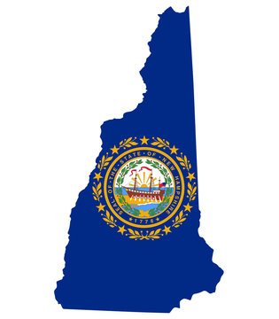
NEW HAMPSHIRE
REPUBLICAN HELD
Incumbent: Governor Chris Sununu*
Democrat Challenger:
Tom Sherman
Libertarian Challengers:
Karlyn Borysenko
Kelly Halldorson
Polling Data:
Gov. Chris Sununu: 52%
Tom Sherman: 39%
(Data for Progress)
(September 30th)
Gov. Chris Sununu: 55%
Tom Sherman: 37%
(U. of New Hampshire)
(September 19th)
Gov. Chris Sununu: 52%
Tom Sherman: 37%
(Emerson College Polling)
(September 15th)
Other Factors to Consider:
U.S. Senate Race
Incumbent: Maggie Hassan (D)
Prediction:
Solid Republican

Slide 28
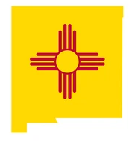
NEW MEXICO
DEMOCRAT HELD
Incumbent: Governor Michelle Lujan Grisham*
Republican Challenger:
Mark Ronchetti
Libertarian Challenger:
Karlyn Borysenk
Polling Data:
Gov. Michelle Lujan Grisham: 48%
Mark Ronchetti: 40%
(Public Policy Polling)
(October 7th)
Gov. Michelle Lujan Grisham: 53%
Mark Ronchetti: 37%
(SurveyUSA Polling)
(October 6th)
Gov. Michelle Lujan Grisham: 48%
Mark Ronchetti: 43%
(Emerson College Polling)
(September 11th)
Other Factors to Consider:
Biden Approval / Disapproval:
As of January, ’22:
41 approve / 57 disapprove
Prediction:
Toss-Up

Slide 29
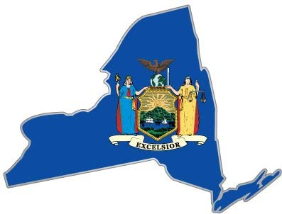
NEW YORK
DEMOCRAT HELD
Incumbent: Governor Kathy Hochul*
Republican Challenger:
Lee Zeldin
Polling Data:
Gov. Kathy Hochul: 50%
Lee Zeldin: 46%
(Quinnipiac University)
(October 16th)
Gov. Kathy Hochul: 50%
Lee Zeldin: 44%
(Schoen Cooperman)
(October 12th)
Gov. Kathy Hochul: 45%
Lee Zeldin: 43%
(Trafalgar Polling)
(October 3rd)
Other Factors to Consider:
U.S. Senate Race
Incumbent: Chuck Schumer (D)
Prediction:
Toss-Up

Slide 30
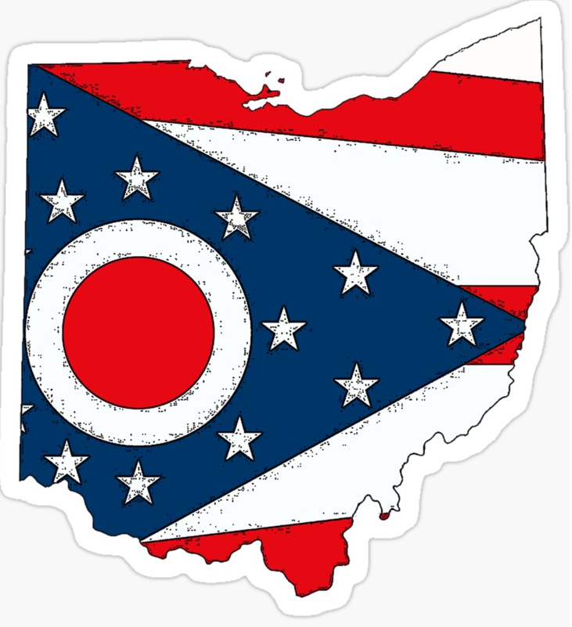
OHIO
REPUBLICAN HELD
Incumbent: Governor Mike DeWine*
Democrat Challenger:
Nan Whaley
Independent Challenger:
Tim Grady
Polling Data:
Nan Whaley: 38%
Gov. Mike DeWine: 56%
(Suffolk University)
(October 15th)
Nan Whaley: 41%
Gov. Mike DeWine: 44%
(Civiqs Polling)
(September 13th)
Nan Whaley: 37%
Gov. Mike DeWine: 55%
(Trafalgar Group)
(October 12th)
Other Factors to Consider:
U.S. Senate Race
Incumbent: OPEN
Prediction:
Likely Republican

Slide 31
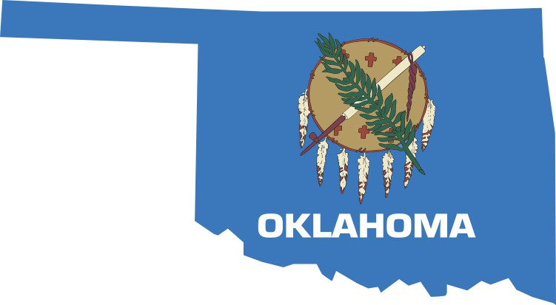
OKLAHOMA
REPUBLICAN HELD
Incumbent: Governor Kevin Stitt*
Democrat Challenger:
Joy Hofmeister*
Independent Challenger:
Ervin Yen
Libertarian Challenger:
Natalie Bruno
Polling Data:
Joy Hofmeister: 46%
Gov. Kevin Stitt: 45%
(American Viewpoint)
(October 15th)
Joy Hofmeister: 47%
Gov. Kevin Stitt: 43%
(SoonerPoll)
(October 6th)
Joy Hofmeister: 44%
Gov. Kevin Stitt: 47%
(Amber Integrated)
(September 21st)
Other Factors to Consider:
U.S. Senate Race
Incumbent: James Lankford (R)
Challenger: Madison Horn (D)
Prediction:
Toss-Up

Slide 32
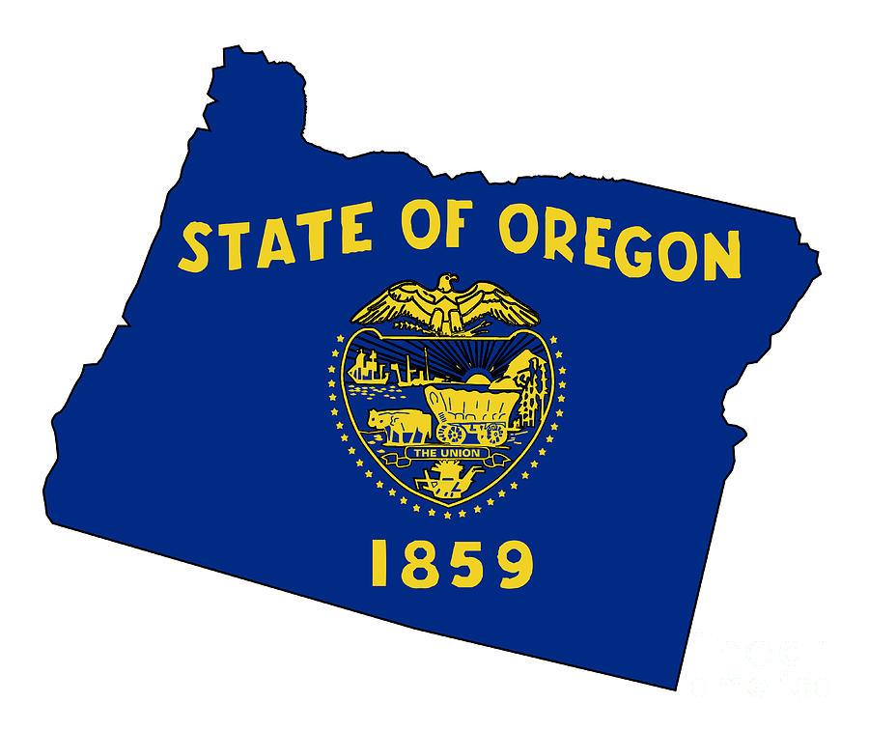
OREGON
DEMOCRAT HELD
Incumbent: OPEN
Libertarian Candidate:
R Leon Noble
Constitution Party of
Oregon Candidate:
Paul Romero
Republican Candidate:
Christine Drazan*
Democrat Candidate:
Tina Kotek
Independent Candidate:
Betsy Johnson
Constitution Party Candidate:
Donice Smith
Polling Data:
Tina Kotek: 35%
Christine Drazan: 37%
(Hoffman Research)
(October 20th)
Tina Kotek: 34%
Christine Drazan: 36%
(Emerson College)
(October 1st)
Tina Kotek: 33%
Christine Drazan: 35%
(DHM Research)
(September 24th)
Other Factors to Consider:
U.S. Senate Race
Incumbent: Ron Wyden (D)
Challenger: Jo Rae Perkins (R)
Prediction:
Toss-Up

Slide 33
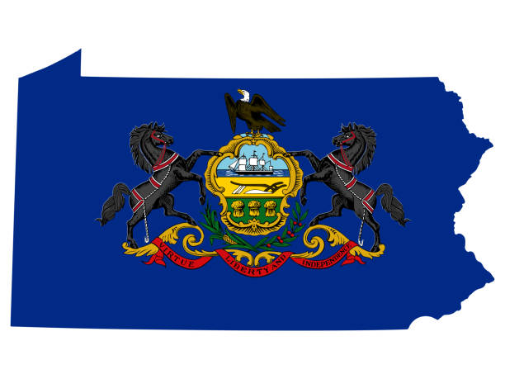
PENNSYLVANIA
DEMOCRAT HELD
Incumbent: OPEN
Republican Candidate:
Doug Mastriano
Democrat Candidate:
AG Josh Shapiro*
Keystone Party of Pennsylvania Candidate:
Joseph Soloski
Libertarian Candidate:
Matt Hackenburg
Green Party Candidate:
Christina Digiulio
Polling Data:
Josh Shapiro: 53%
Doug Mastriano: 44%
(InsiderAdvantage)
(October 11th)
Josh Shapiro: 48%
Doug Mastriano: 37%
(Suffolk University)
(September 30th)
Josh Shapiro: 53%
Doug Mastriano: 40%
(Marist College Polling)
(September 22nd)
Other Factors to Consider:
U.S. Senate Race
Incumbent: OPEN
Prediction:
Lean Democrat

Slide 34
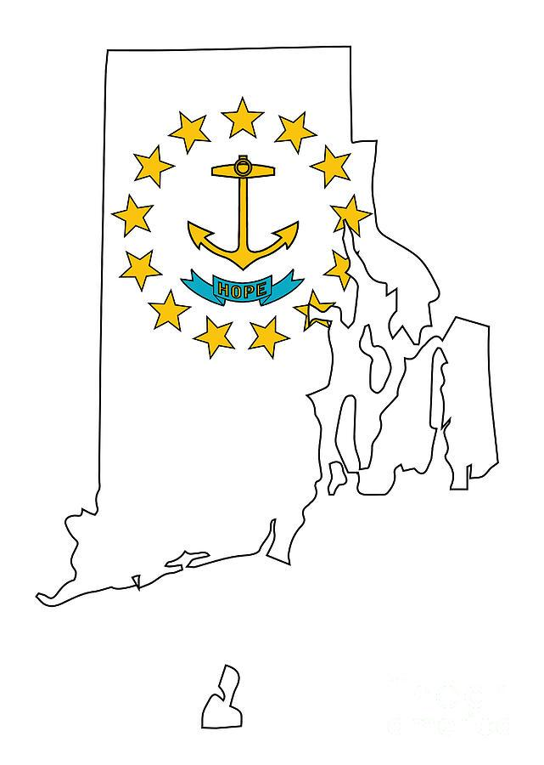
RHODE ISLAND
DEMOCRAT HELD
Incumbent: Governor Daniel McKee*
Republican Challenger:
Ashley Klaus
Independent Challengers:
Paul Rianna Jr.
Zachary Baker Hurwitz
Libertarian Party Challenger:
Elijah Gizzarelli
Polling Data:
Gov. Daniel McKee: 46%
Ashley Klaus: 36%
(Boston Globe)
(October 4th)
Gov. Daniel McKee: 45%
Ashley Klaus: 32%
(Boston Globe)
(October 2nd)
Prediction:
Likely Democrat

Slide 35
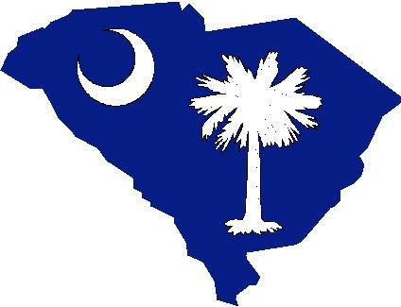
SOUTH CAROLINA
REPUBLICAN HELD
Incumbent: Governor Henry McMaster*
Democrat Challenger:
Joe Cunningham
Libertarian Challenger:
Morgan Bruce Reeves
Polling Data:
Joe Cunningham: 44%
Gov. Henry McMaster: 50%
(Echelon Insights Polling)
(September 7th)
Joe Cunningham: 43%
Gov. Henry McMaster: 51%
(Trafalgar Polling)
(August 28th)
Other Factors to Consider:
U.S. Senate Race
Incumbent: Tim Scott (R)
Challenger: Krystle Matthews (D)
Prediction:
Solid Republican

Slide 36
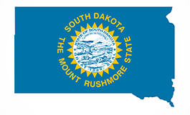
SOUTH DAKOTA
REPUBLICAN HELD
Incumbent: Governor Kristi Noem*
Democrat Challenger:
Jamie Smith
Libertarian Challenger:
Tracey Quint
Polling Data:
Jamie Smith: 42%
Gov. Kristi Noem: 45%
(SDSU Polling)
(October 6th)
Other Factors to Consider:
U.S. Senate Race
Incumbent: John Thune (R)
Challenger: Brian Bengs (D)
Prediction:
Likely Republican

Slide 37
TENNESSEE
REPUBLICAN HELD
Incumbent: Governor Bill Lee*
Democrat Challenger:
Jason Martin
Independent Challengers:
Constance Every
John Gentry
Basil Marceaux
Charles Morgan
Alfred O’Neil
Deborah Rouse
Michael Scantland
Rick Tyler
Polling Data:
Jason Martin: 42%
Gov. Bill Lee: 52%
(SSRS)
(September 7th)
Jason Martin: 39%
Gov. Bill Lee: 56%
(Marist College Polling)
(September 7th)
Jason Martin: 36%
Gov. Bill Lee: 59%
(Cygnal Polling)
(September 7th)
Prediction:
Solid Republican

Slide 38
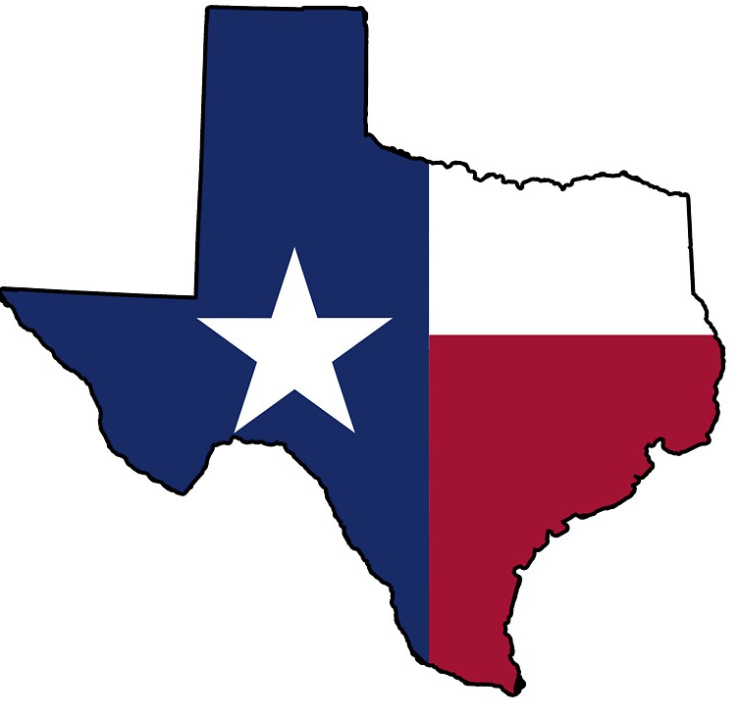
TEXAS
REPUBLICAN HELD
Incumbent: Governor Greg Abbott*
Democrat Challenger:
Beto O’Rourke
Independent Challengers:
Jacqueline Abernathy
Mark Goloby
Libertarian Challenger:
Mark Tippetts
Green Party Challenger:
Delilah Barrios
Polling Data:
Beto O’Rourke: 44%
Gov. Greg Abbott: 52%
(Civiqs)
(October 11th)
Beto O’Rourke: 45%
Gov. Greg Abbott: 49%
(Marist Polling)
(October 6th)
Beto O’Rourke: 43%
Gov. Greg Abbott: 45%
(Echelon Insights Polling)
(September 7th)
Prediction:
Solid Republican

Slide 39
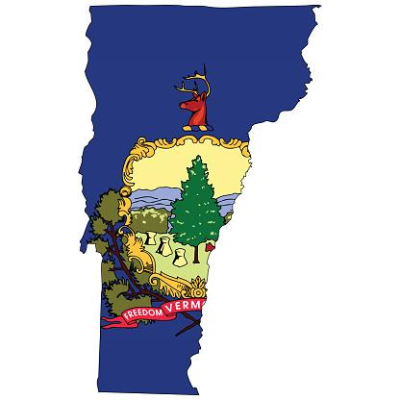
VERMONT
REPUBLICAN HELD
Incumbent: Governor Phil Scott*
Democratic/Progressive Challenger:
Brenda Siegel
Independent Challengers:
Peter Duval
Kevin Hoyt
Bernard Peters
Polling Data:
Brenda Siegel: 31%
Gov. Phil Scott: 48%
(University of New Hampshire Polling)
(October 3rd)
Other Factors to Consider:
U.S. Senate Race
Incumbent: OPEN
Prediction:
Likely Republican

Slide 40
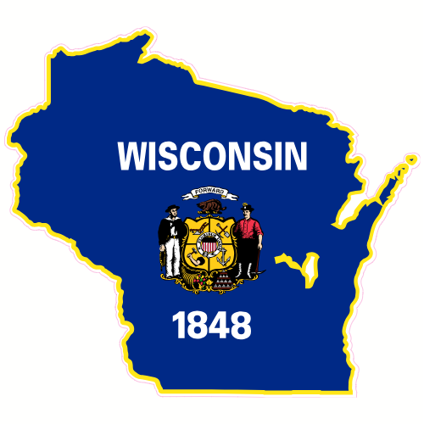
WISCONSIN
DEMOCRAT HELD
Incumbent: Governor Tony Evers*
Republican Challenger:
Tim Michels*
Polling Data:
Tony Evers: 47%
Tim Michels: 46%
(Marquette Polling)
(October 9th)
Tony Evers: 50%
Tim Michels: 50%
(YouGov Polling)
(October 7th)
Tony Evers: 47%
Tim Michels: 49%
(Fox News Polling)
(September 26th)
Other Factors to Consider:
U.S. Senate Race
Incumbent: Ron Johnson (R)
Generic Ballot: +4 for GOP
Biden is unfavorable (mid 50s)
Prediction:
Toss-Up

Slide 41
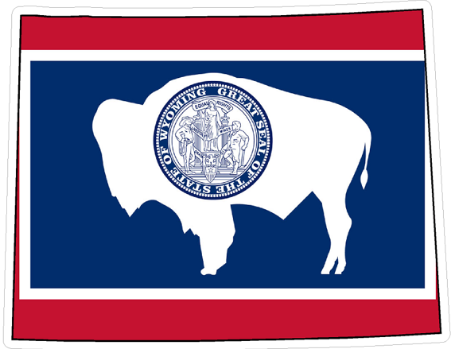
WYOMING
REPUBLICAN HELD
Incumbent: Governor Mark Gordon*
Democratic Challenger:
Theresa Livingston
Libertarian Party Challenger:
Jared Baldes
Other Factors to Consider:
Voter Registration in Wyoming:
71% Republican
15% Democrat
Prediction:
Solid Republican

Slide 42
Toss-Up States Campaign Ads

Slide 43
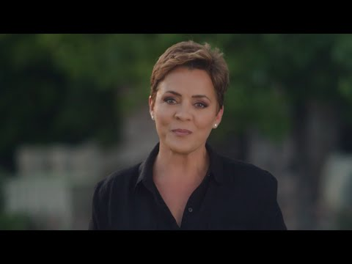
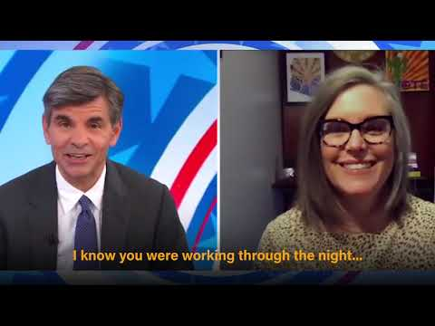
ARIZONA
REPUBLICAN HELD
Incumbent: OPEN SEAT
Kari Lake
Katie Hobbs
Prediction:
Toss-Up

Slide 44
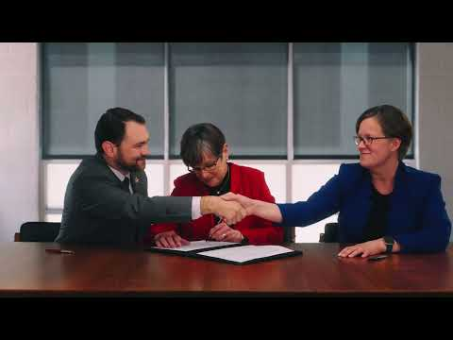
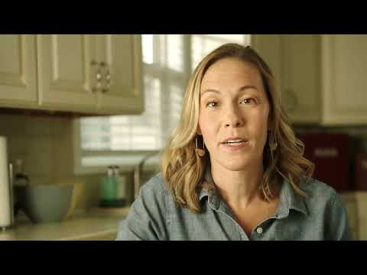
KANSAS
DEMOCRAT HELD
Incumbent: Governor Laura Kelly*
Governor Laura Kelly
Derek Schmidt
Prediction:
Toss-Up

Slide 45
MAINE
DEMOCRAT HELD
Incumbent: Governor Janet Mills
Governor Janet Mills
Fmr. Governor
Paul LePage
Prediction:
Toss-Up

Slide 46
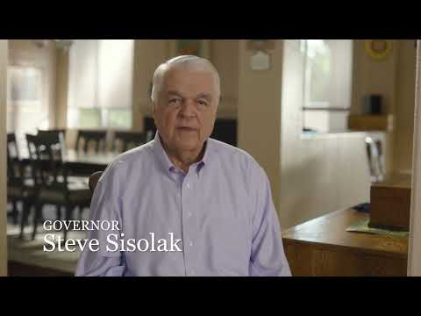
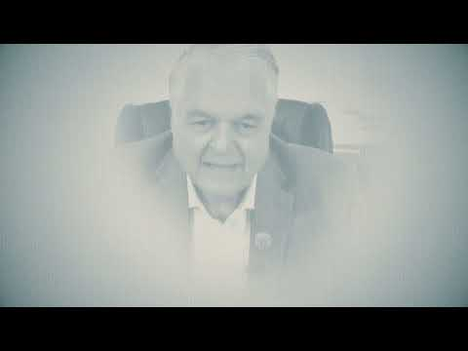
NEVADA
DEMOCRAT HELD
Incumbent: Governor Steve Sisolak*
Governor Steve Sisolak
Prediction:
Toss-Up
Sheriff Joe Lombardo

Slide 47
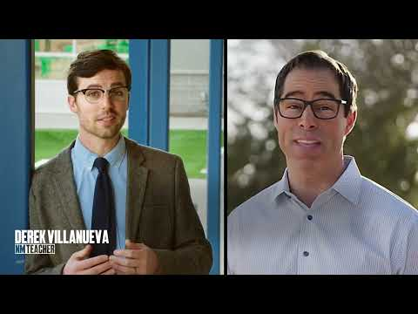
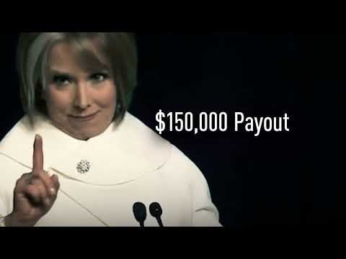
NEW MEXICO
DEMOCRAT HELD
Incumbent: Governor Michelle Lujan Grisham*
Governor Michelle Lujan Grisham
Mark Ronchetti
Prediction:
Toss-Up

Slide 48
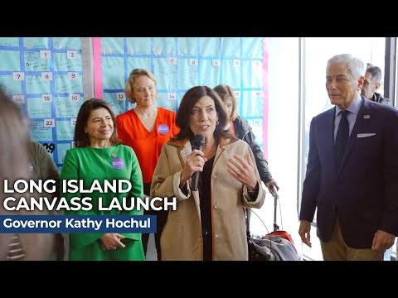
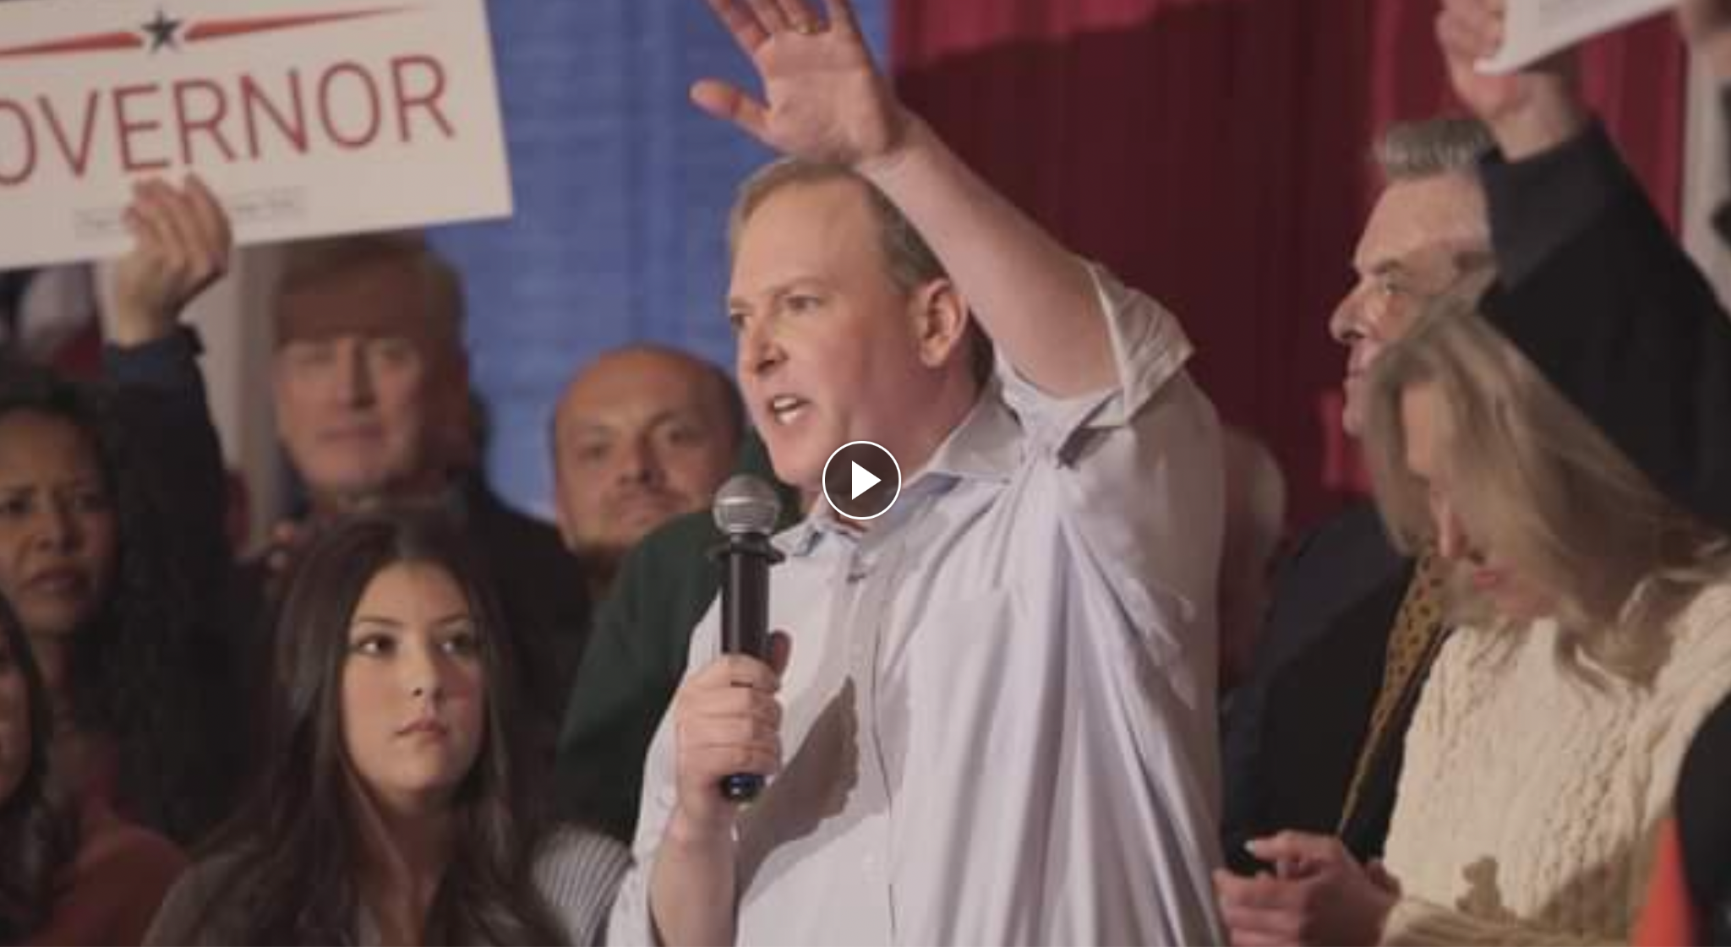
NEW YORK
DEMOCRAT HELD
Incumbent: Governor Kathy Hochul*
Governor Kathy Hochul
Lee Zeldin
Prediction:
Toss-Up

Slide 49
OKLAHOMA
REPUBLICAN HELD
Incumbent: Governor Kevin Stitt*
Governor Kevin Stitt
Joy Hofmeister
Prediction:
Toss-Up

Slide 50
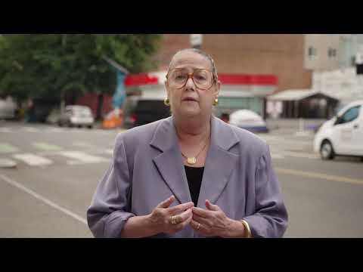
OREGON
DEMOCRAT HELD
Incumbent: OPEN
Christine Drazan
Betsy Johnson
Tina Kotek
Prediction:
Toss-Up

Slide 51
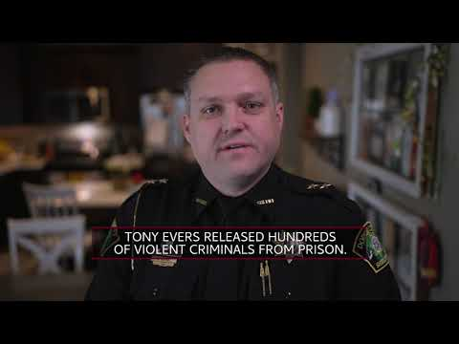
WISCONSIN
DEMOCRAT HELD
Incumbent: Governor Tony Evers*
Governor Tony Evers
Tim Michels
Prediction:
Toss-Up

